Slide 1
Peng Qiu, Michaël Barbier, Marlies Verschuuren

Slide 2
Plate Differences
ALL
CTRL

Slide 3
Workplan
1
2
3
4
Norm. based on ctrl
Feature Groups
* Corr
Feature red.
* Var
Evaluation

Slide 4
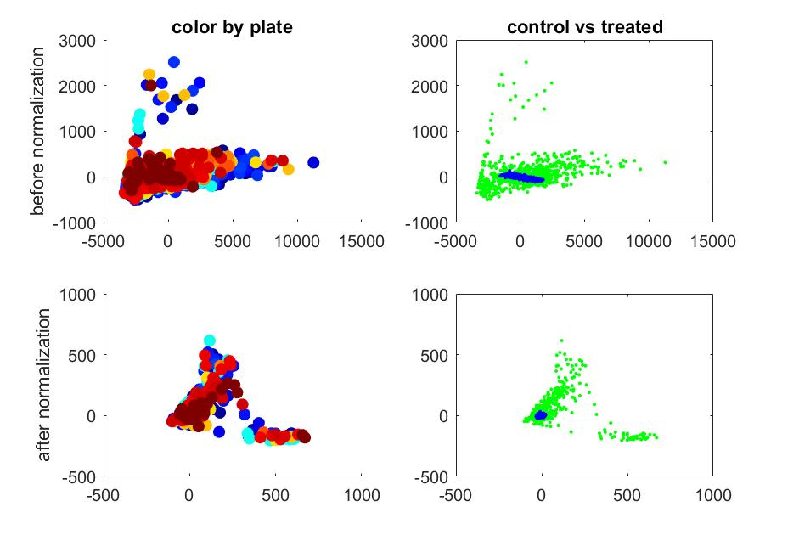
1
For each plate:
take the 64 control wells
compute the mean and std of all 824 features using the control wells
normalize data data for each feature by the mean and std
visualize before and after using PCA
observe shrinkage of the distribution of the controls
Norm. based on ctrl

Slide 5
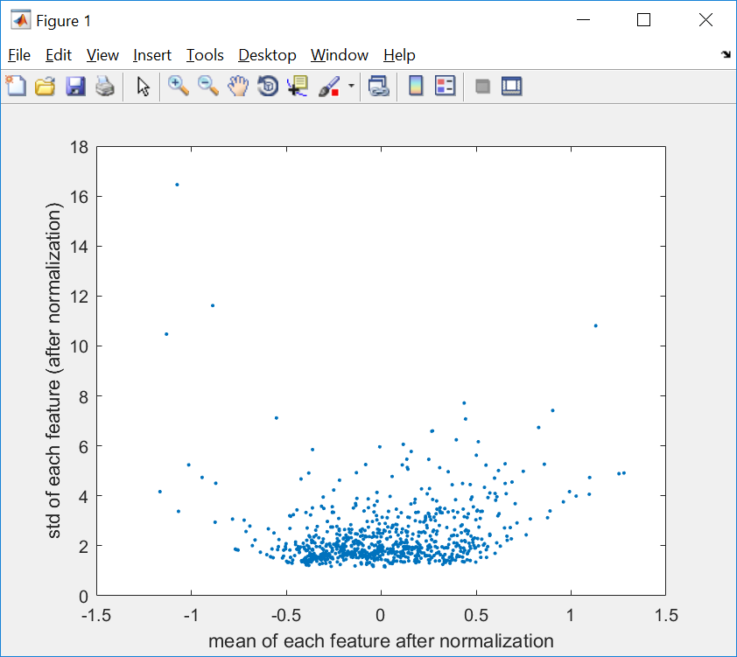
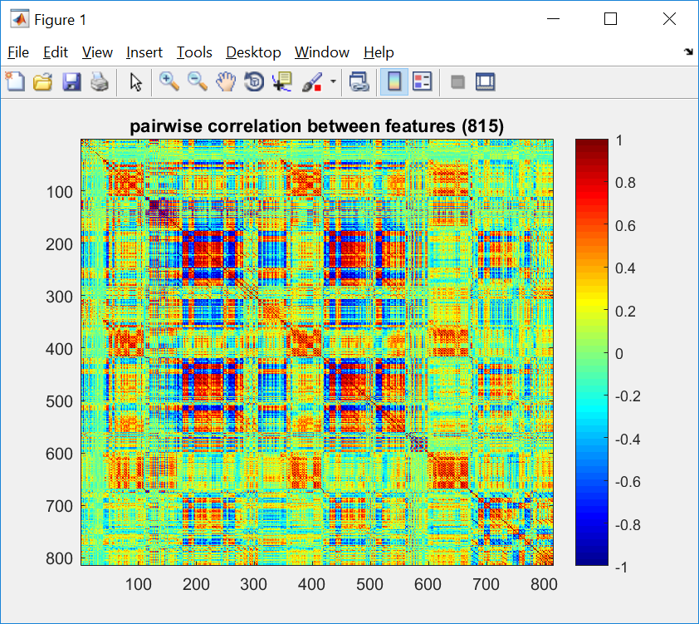
2
Feature Groups
* Corr
Features are not equally important
Features can be highly correlated

Slide 6
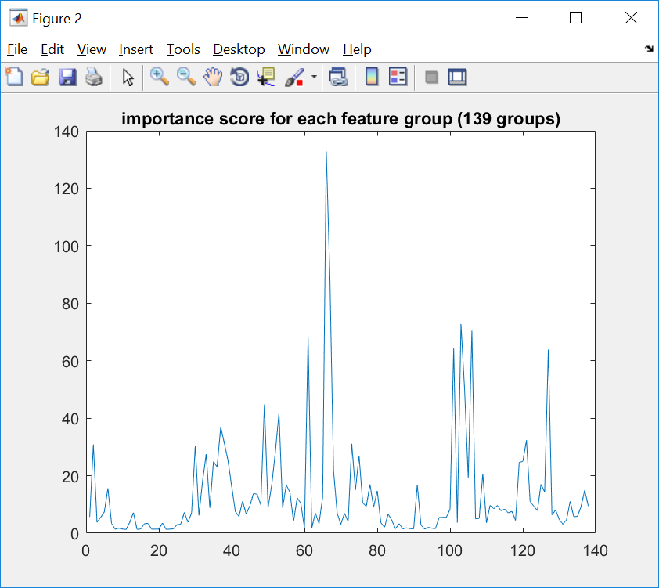
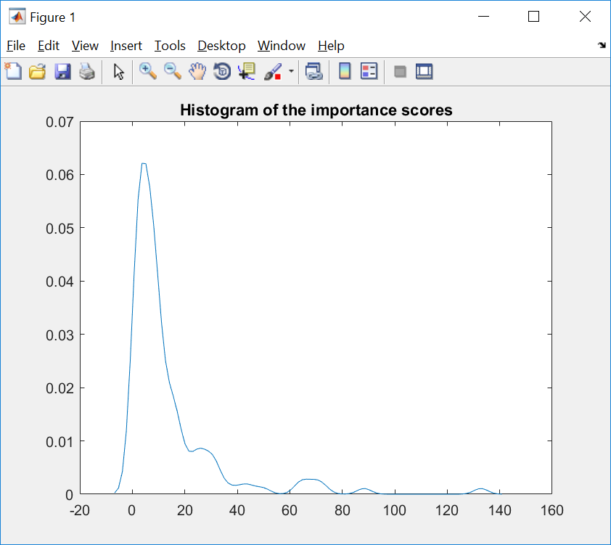
3
Feature red.
* Var
Group features based on correlation, 0.9
Selected important feature groups (26)

Slide 7
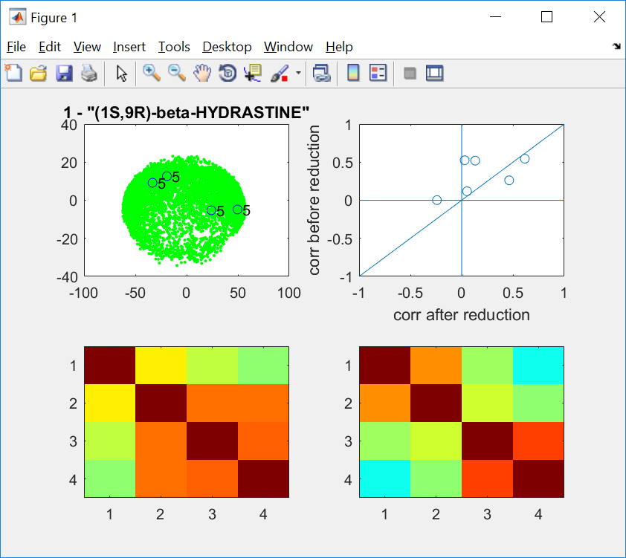
4
Evaluation

Slide 8
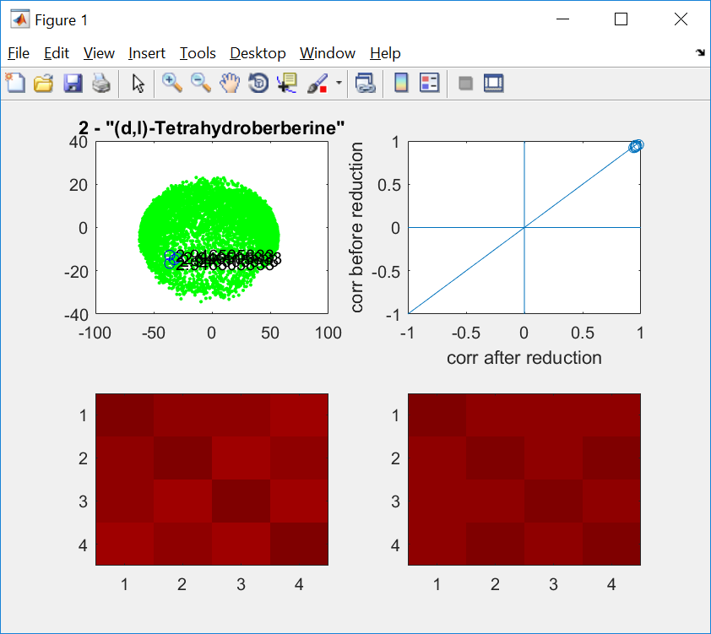
4
Evaluation

Slide 9
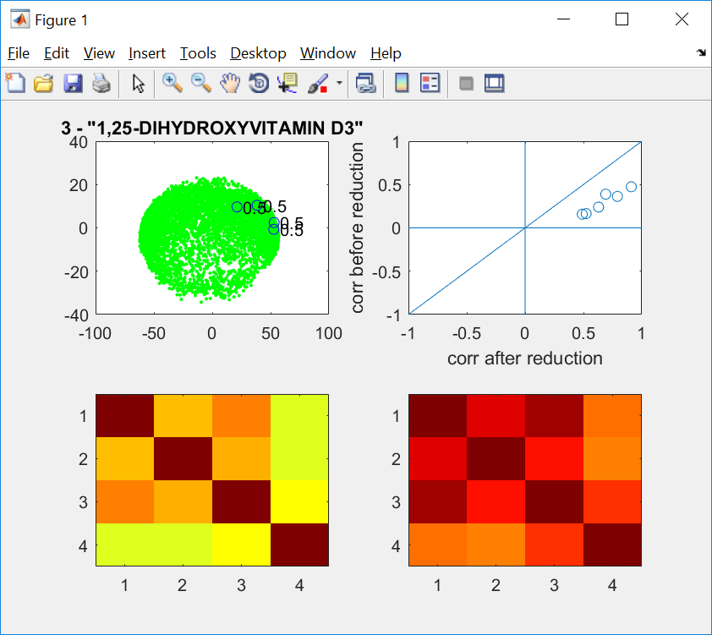
4
Evaluation

Slide 10
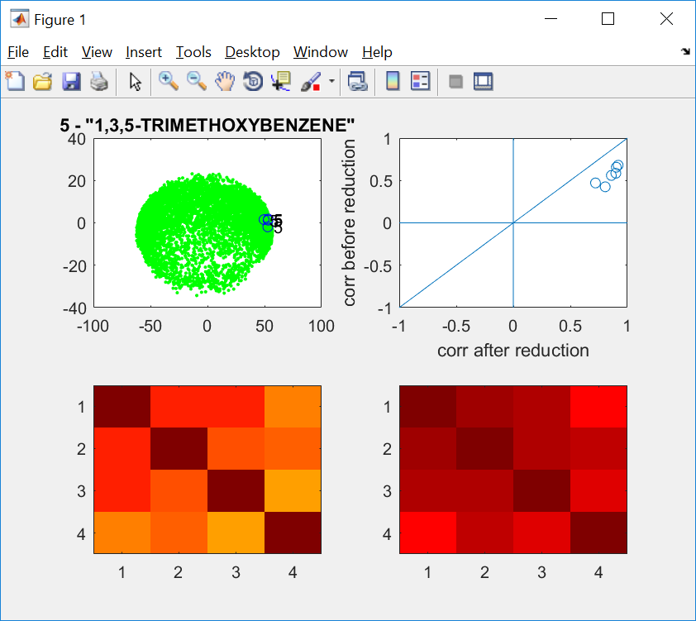
4
Evaluation

Slide 11
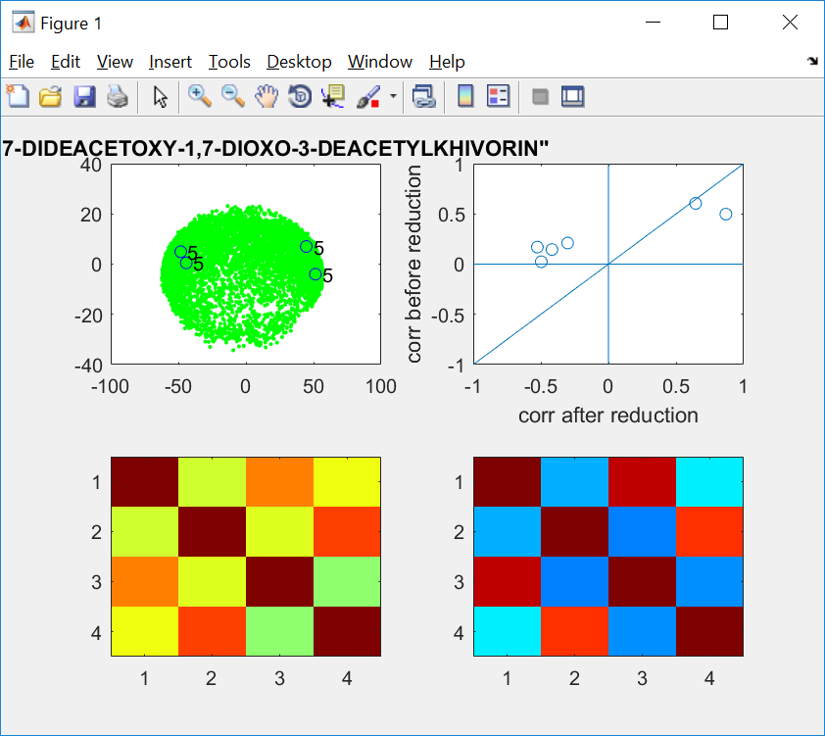
4
Evaluation

Slide 12
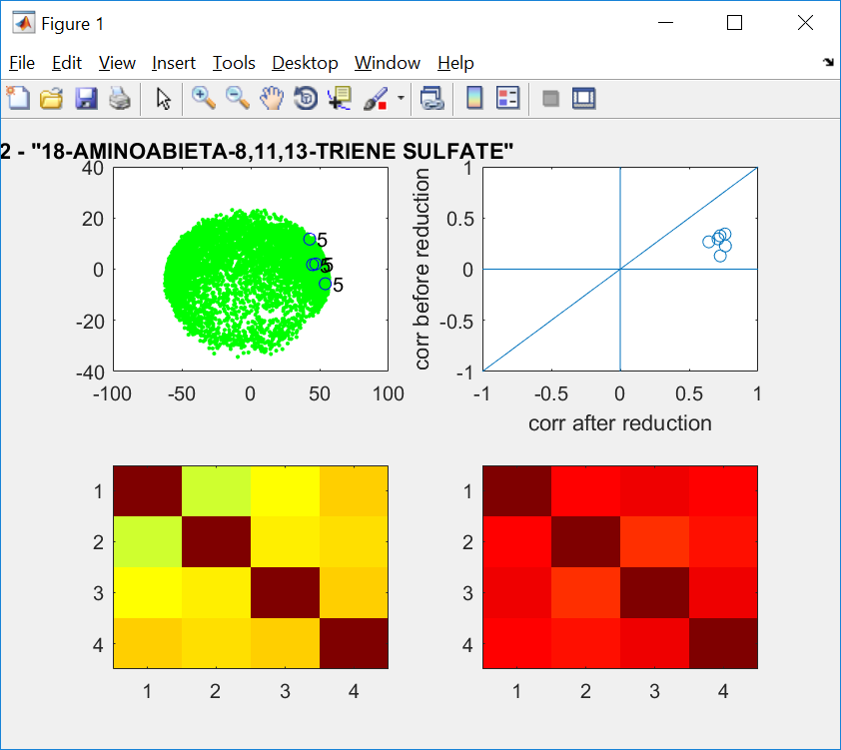
4
Evaluation

Slide 13
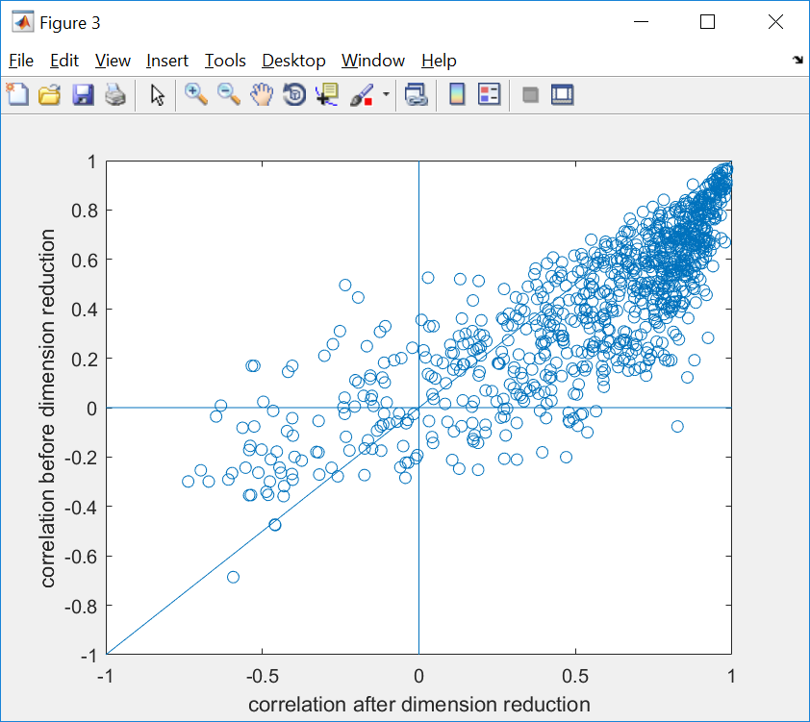
4
Is this helping? ☺ or ☹
Evaluation

